Slide 1
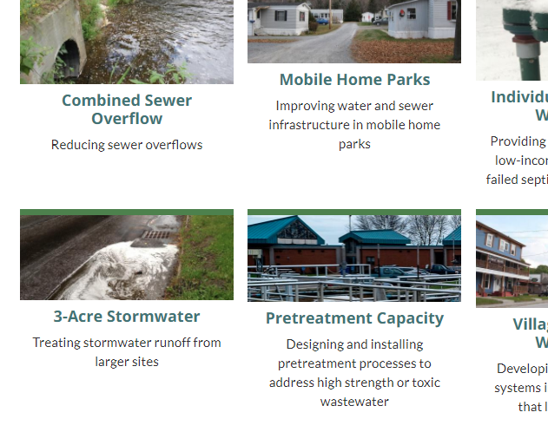
Overview of ARPA-Funded Water Infrastructure Initiatives
Oct 7th, 2021
Vermont Agency of Natural Resources

Slide 2
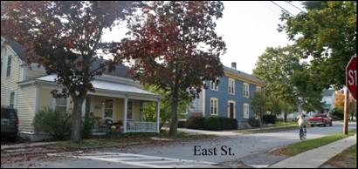
Healthy Homes Initiative
Grants for projects that provide clean and adequate drinking water, wastewater, stormwater and drainage systems for dwelling units occupied by low-income Vermonters
Two tranches of funding:
Manufactured Home Communities
On-site/residential systems

Slide 3
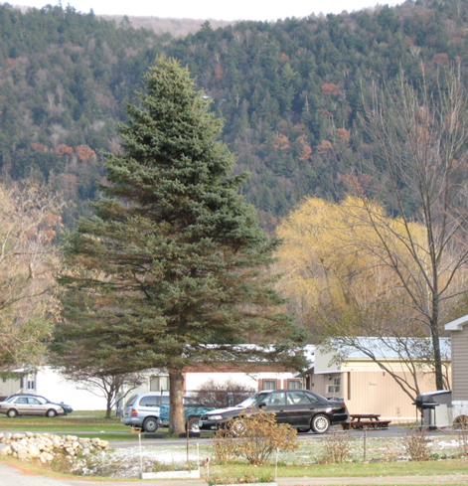
Healthy Homes – Manufactured Home Communities
Grants available to support both needs assessment and construction
Needs assessment
Grants anticipated to be a maximum of $75,000 per MHC
Anticipate supporting 15-20 assessments in FY22
Construction
Grants will be a maximum of $1,500,000 per MHC
Anticipate supporting 3-7 projects per year
RFP issued in late-2021; $3.25m is available in FY22
Coordination with federal delegation is on-going
re: community-sponsored projects

Slide 4
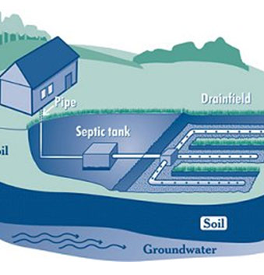
Healthy Homes Initiative – On-site
Grants available to single family homeowners and owner-occupied multi-unit residential buildings for failed (or failing) water or wastewater systems
Grants will be scaled to income-based need
Fixed award to offset project costs
Anticipate supporting 20-50 projects per year
Availability notice late 2021; $1m in FY22
Coordination with VLCT, RPCs, Community-lenders and associations to broadly disseminate information to eligible homeowners

Slide 5
Pretreatment Initiative
Grants to:
Municipal facilities challenged to manage incoming commercial/industrial wastewater; and/or
Private enterprises seeking to grow-in-place but limited by the ability of the receiving facility to accept their high-strength or toxic wastewater
Approach
RFI to be issued this month.
Responses will inform development of RFP and cost share rates
RFP issued late-2021; $2m is available in FY22
Facilities installing pretreatment technologies with these funds will need to obtain a user permit to ensure on-going O&M

Slide 6
Village Water & Sewer Initiative
Grants to village centers that lack adequate community-scale water and/or wastewater infrastructure
Used to support final engineering design and construction
Grants scaled to ensure affordability for user rates
Grants will be used to supplement existing grant programs.
Approach
Target the ~35 communities that have completed an initial evaluation of a community-scale system(s) in their municipality
RFP issued Fall 2021; $8m in FY22

Slide 7
Sewer Overflow Initiative
Grants to accelerate elimination of sewer overflows
All communities with sewer overflows are establishing long-term compliance schedules; more than $60m in projects identified
Several municipalities are currently in the process of designing solutions to this costly issue.
Approach
Municipalities will apply thru existing framework for state revolving loan funds (Project Priority List) but awards will be 100% grant
Will be ranked using existing Municipal Pollution Control Priority System for biggest water quality results
$10m available in FY22

Slide 8
3-Acre Stormwater Initiative
Grants to property owners to enable compliance with state and federal requirements for stormwater management
$5.5M available for FY22
Supplemented by Clean Water Board with $3.5M
Approach
ANR will hire engineering contractor(s) to provide site assessment, design and permitting, and construction management services for individual property owners / HOAs, small businesses.
ANR will also enhance support for the Green Schools Initiative
RFP issued Fall 2021; $3-6M in FY22 (early focus on site assessment and design)
RFP for final design and construction of public-private partnership projects will be issued late-2021; $2-4M in FY22

Slide 9
Clean Water Projects
$10M/year for FY22, FY23, FY24
Directed by the Clean Water Board. For FY22:
$3.5M to Agency of Ag. Food and Markets to support WQ Grants
$3.5 to Support Three-acre stormwater requirements
$3M to enhance Pollution Control Grants

Slide 10
To Get Involved:
https://anr.vermont.gov/content/arpa-vermont

